Slide 1
E-Business and E-Commerce
I dag
SCM og logistic
Wilsons formel
E-business

Slide 2
Learning outcomes
You should be able to:
Define the meaning and scope of e-business and e-commerce
Summarize the main reasons for adopting e-commerce and e-business and which barriers you might encounter
Outline the ongoing business challenges of managing e-business and e-commerce in an organisation
Identify some of the main business models
Outline the hardware and software technologies used to build an e-business infrastructure within an organization (next session)

Slide 3
Networks
Internet
The Internet is a global system of interconnected computer networks that use the standard Internet protocol suite (TCP/IP) to serve several billion users worldwide.
Extranet
An extranet is a computer network that allows controlled access from the outside, in isolation from other internet users.
Intranet
A private network within a single company using internet standards to enable employees to access and share information.

Slide 4
E-commerce defined
All electronically mediated information exchanges between an organization and its external stakeholders
Social commerce – encouraging participation and interaction of customers in ratings etc. of products.
Examples:
Buying books online (transactional)
Selecting a car online (informational)
Customer support – service query (service oriented)

Slide 5
E-business defined
All electronically mediated information exchanges, both within an organization and with external stakeholders supporting the range of business processes
Examples:
Purchasing from suppliers (e-procurement)
A company intranet
Supplying partners with information through an extranet

Slide 6
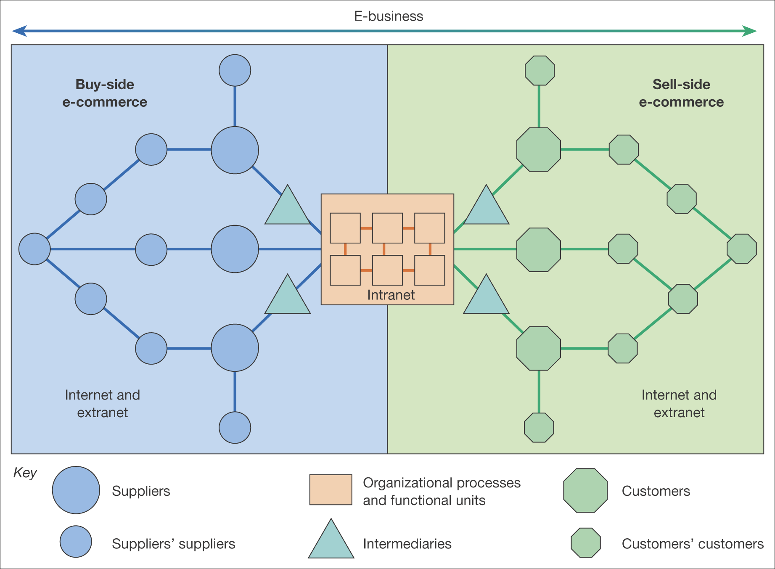
E-business and E-commerce

Slide 7
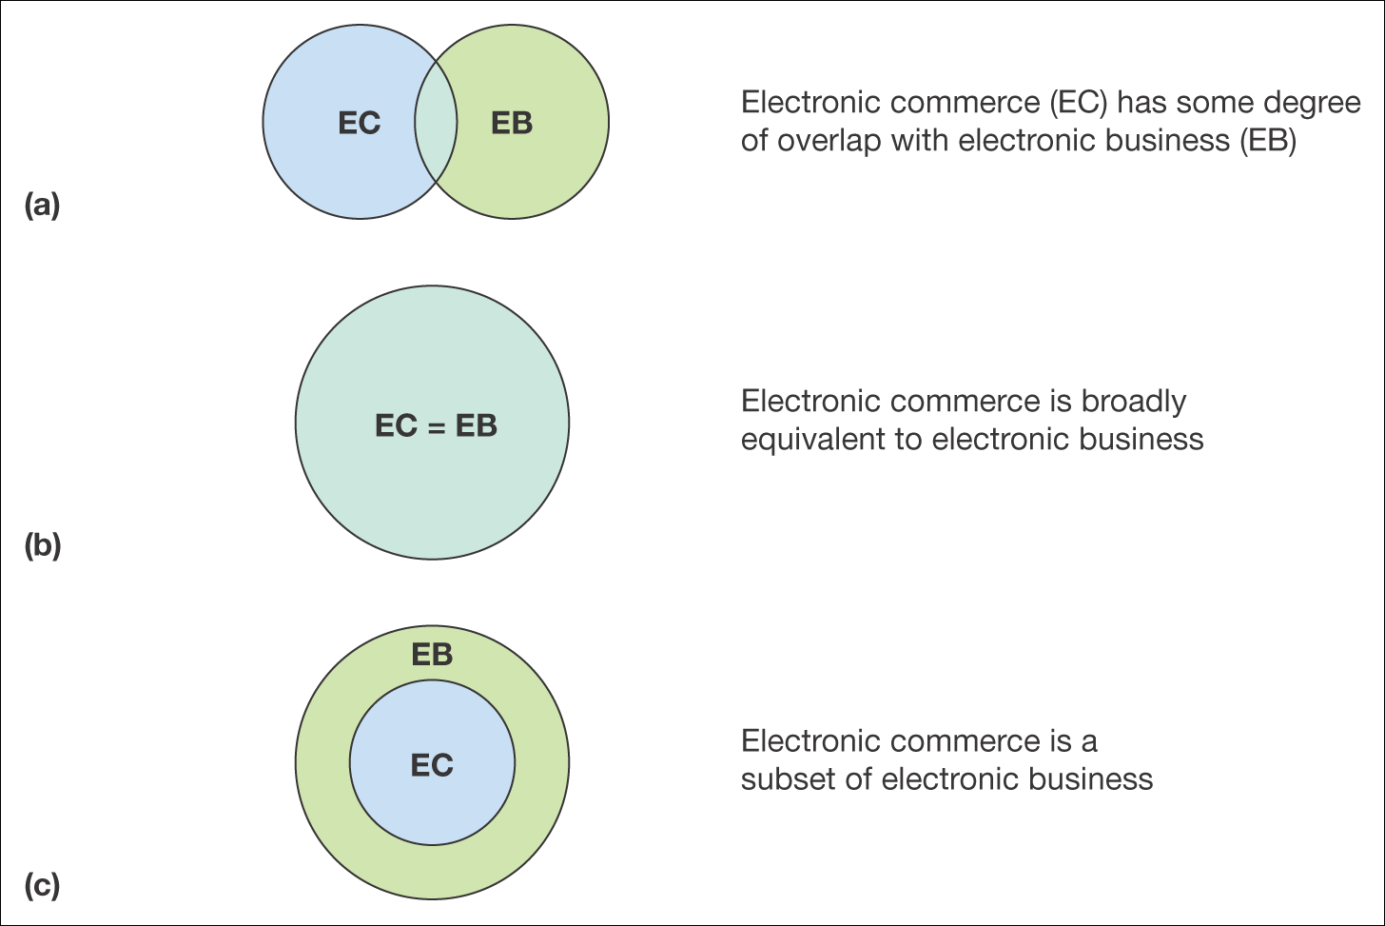
E-business and E-commerce

Slide 8
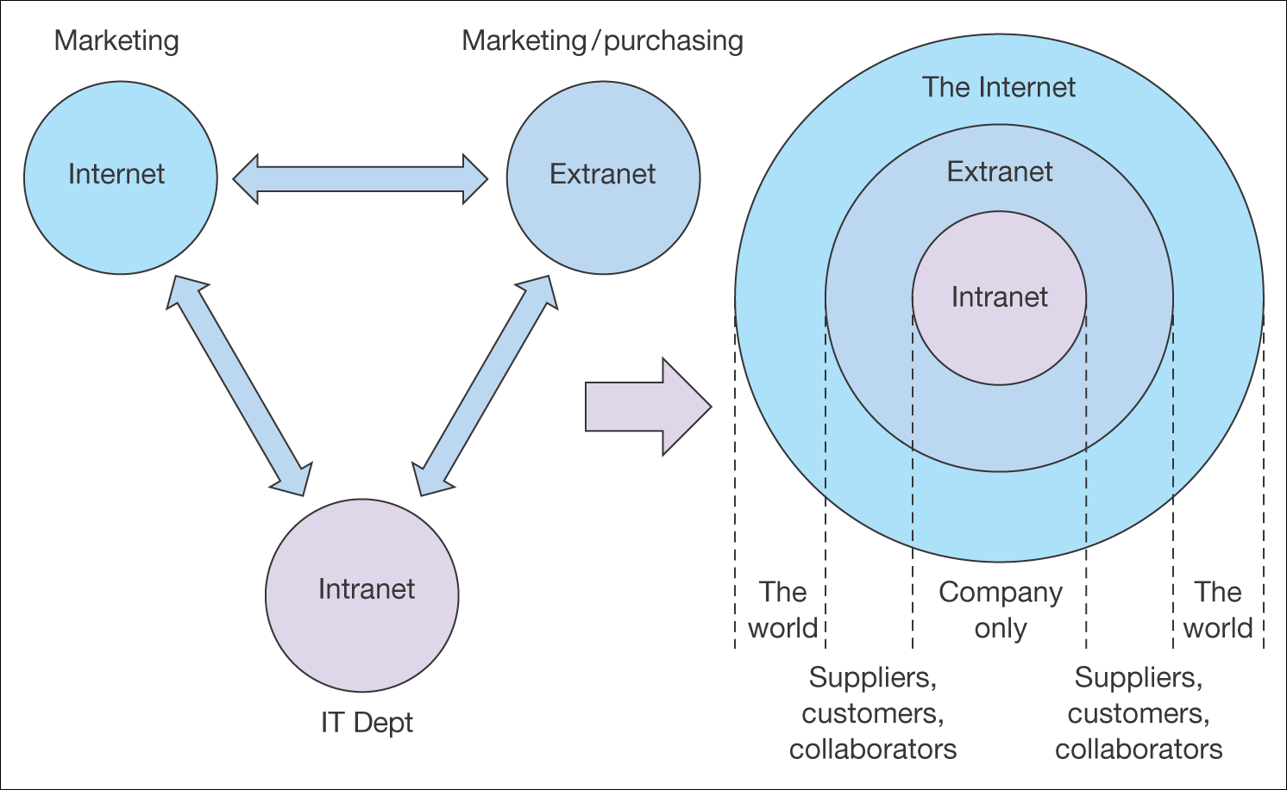
E-business and E-commerce

Slide 9
Types of sell-side e-commerce
Transactional e-commerce sites
Enable the user to buy products online
Service-oriented relationship-building sites
Provide information to stimulate purchase and build relationship. Products are not typically available for purchase online
Brand-building sites
Provide an experience to support the brand

Slide 10
Types of sell-side e-commerce
Portal, publisher or media sites
Provide information, news or entertainment about a range of topics. It contains both own information and links to other sites.
Social networks
Social networks which influences companies and customer communication.

Slide 11
Sell-side e-commerce exercise
Please find a web site for each type of sell-side e-commerce (and one that supports all types)
Prepare to show them for the class

Slide 12
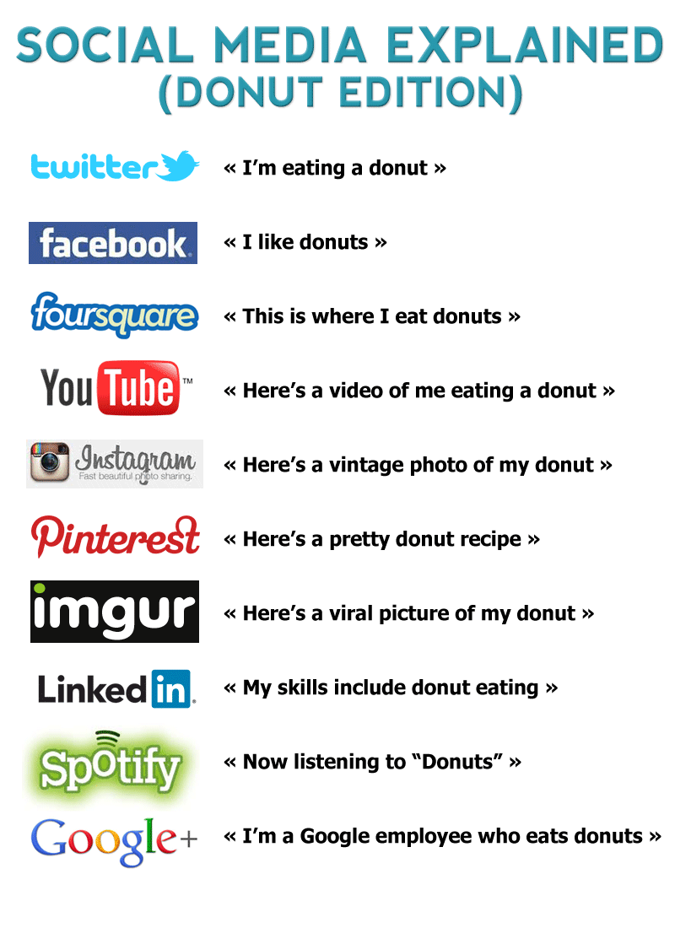
Social media explained

Slide 13
Enterprise social media software
Office communicator
What about public social media software?
Twitter?
Facebook?
What are the benefits?
What are the risks/drawbacks?
What do you think of mixing professional and personal “social media”?
How does your public profile look on the internet (google yourself) – which kind of information does a potential employer see?

Slide 14
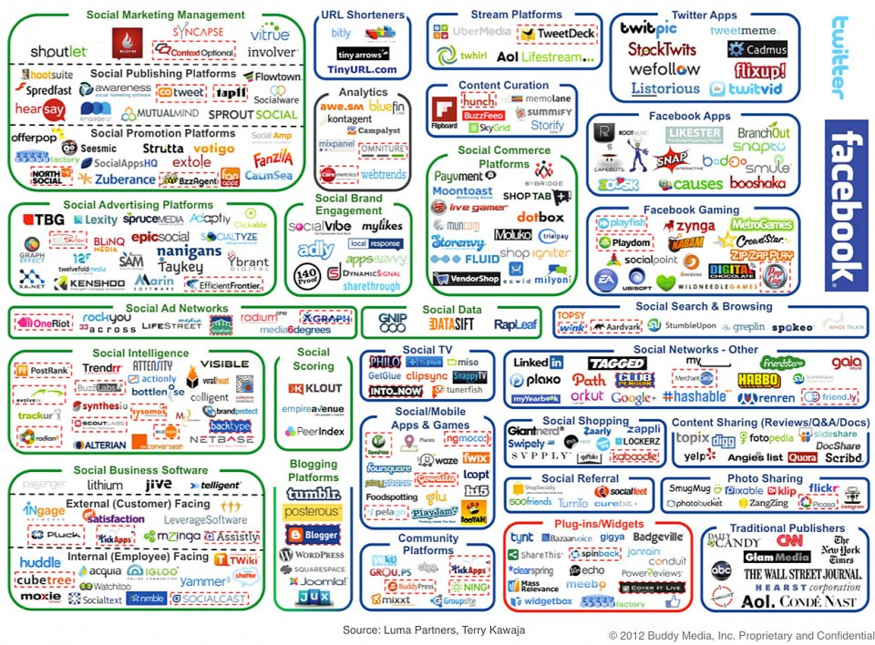
Enterprise social media software

Slide 15
Digital marketing
Management and execution of marketing using electronic media such as the web, e-mail etc. in conjunction with digital data about customers’ characteristics and behaviour.

Slide 16
Types of digital marketing
Search engine marketing
Google adwords, SEO etc.
Online PR
Online partnerships
Interactive advertising
Opt-in e-mail marketing
Email that is sent to many people at the same time
Social media marketing

Slide 17
Exercises - digital marketing
Please find an online example on:
SEO (Search Engine Optimization)
Opt-in e-mail marketing
Social media marketing
Interactive advertising

Slide 18
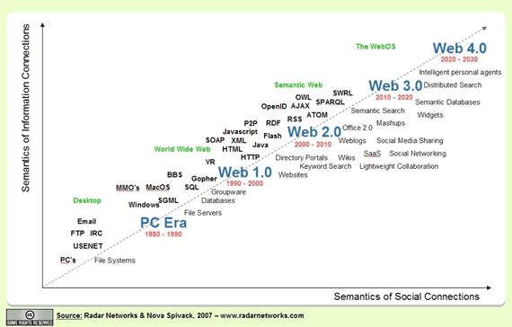
Evolution of web technologies

Slide 19
Group exercise– where are we today?
In relation to web technologies, please discuss in your groups where we are today – web 2.0, web 3.0 or …?
Find online examples on the technology you refer to
Which opportunities do this technology provide organisations in relation to e-business/commerce?

Slide 20
E-commerce – transaction models
Business-To-Consumer (B2C)
Commercial transactions between an organisation and consumers
Business-To-Business (B2B)
Commercial transactions between an organisation and other organisations
Consumer-To-Consumer (C2C)
Information or financial transactions between consumers, but usually mediated through a business site
Consumer-To-Business (C2B)
Consumers approach the business with an offer

Slide 21
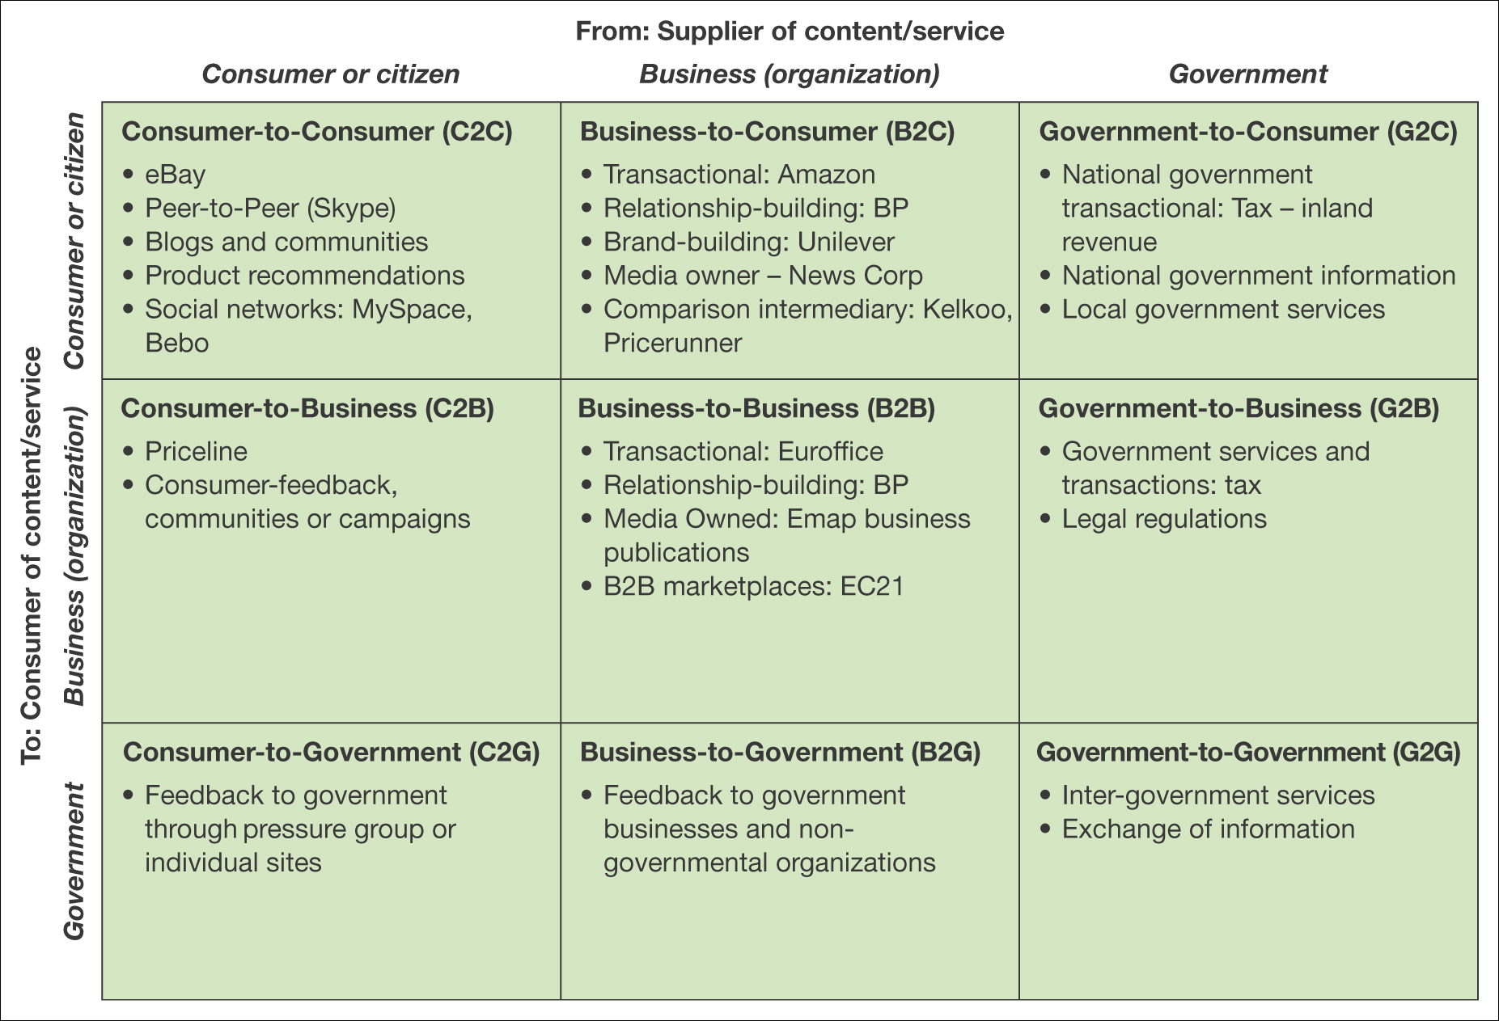
E-commerce – transaction models

Slide 22
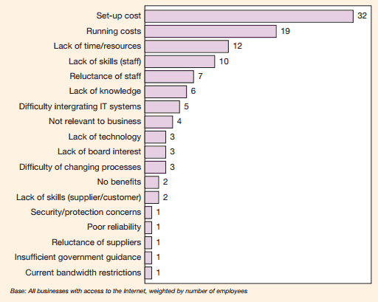
Risks and barriers to e-business

Slide 23
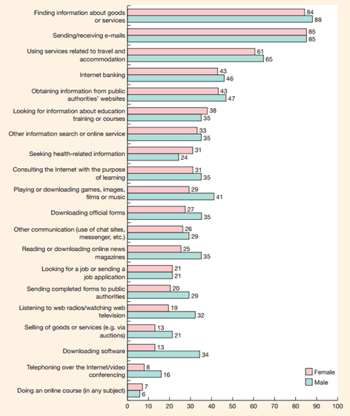
Activities by gender

Slide 24
1st year project
Go through the ideas in ”Suggested contents” and write down what to include in your project (All parts are not relevant for all projects!).
Create a “table of contents” for your project
Start the preliminary investigation in relation to your project
Project plan
…

